Slide 1
Coffee Shop Sales Data – RFM Analysis
Submitted By:
Krishna Goswami

Slide 2
Agenda
Business Objectives
Data Preparation
Data Analysis
Modeling
Insights & Recommendations

Slide 3
Business Objectives
Analyze Sales Transaction Data of a coffee store using RFM analysis method.
RFM ( recency, frequency, monetary) analysis is a marketing and customer segmentation technique that uses past purchase behavior to divide customers into groups .
RECENCY (R): Time since last purchase FREQUENCY (F): Total number of purchases MONETARY VALUE (M): Total monetary value
Provide recommendation/insights based on analyze to improve revenue.

Slide 4
Data Understanding

Slide 5
Brief about the dataset
We have 3 datasets available – Customer Level Dataset, Transaction Level Data Set and Item Level Data Set.
The datasets pertain to a coffee store that has an app, which can be used by customers to earn loyalty points and also pay digitally.
Customer Level Dataset – Total No of records is 10767
Transaction Level Dataset – Total No of records is 17164
Item Level Dataset – Total No of records is 17972
The details about the columns of the datasets is attached below for reference:

Slide 6
Data Preparation

Slide 7
Main Data Marts/Tables
Created a new table “trans_items_cust_merge” containing all the records of customers, items and transactions.
Created RFMSEGMENTATION table for storing below information grouped by CustomerID from trans_items_cust_merge table
CustomerID, Recency, Frequency, Products, Tenure, Monetary

Slide 8
Data Analysis

Slide 9
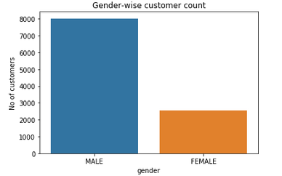
Gender-Wise Sales

Slide 10
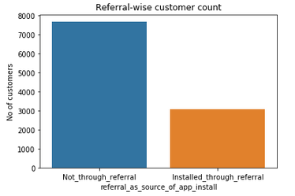
Referral-wise Customer Count

Slide 11
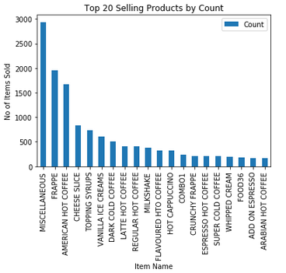
Top 20 Selling Products by Count

Slide 12
Contribution Analysis – Products and Stores
Decile Analysis is performed based on Products and Stores-wise Revenue.
The results are shared in next slides.

Slide 13
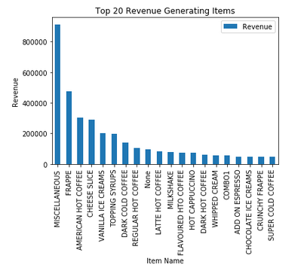
Top 20 Selling Products by Revenue

Slide 14
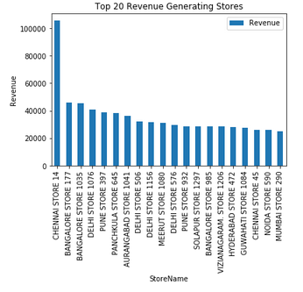
TOP 20 Stores by Revenue

Slide 15
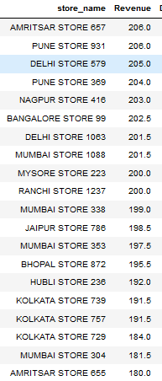
Least Revenue Generating Stores

Slide 16
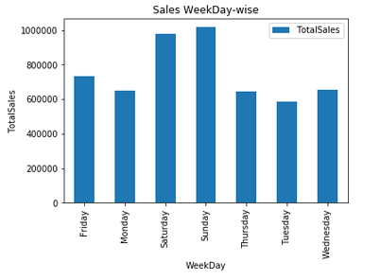
Sales Weekday-wise

Slide 17
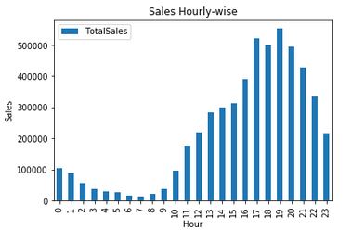
Sales Hourly-wise

Slide 18
Modeling

Slide 19
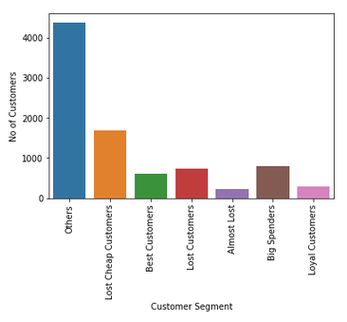
Customer Segmentation
Customers are divided into multiple segments based on their RFM scoring (ratings are given from 1 to 5, 1 being lowest and 5 being highest)

Slide 20
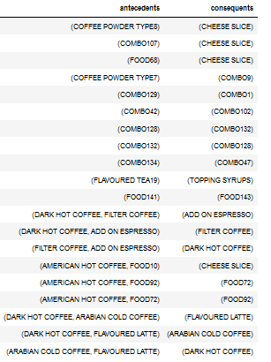
Product Affinity Model Building
Product Affinity model has been built using apriori algorithm.
Top 20 association rules using lift metric is given for reference:

Slide 21
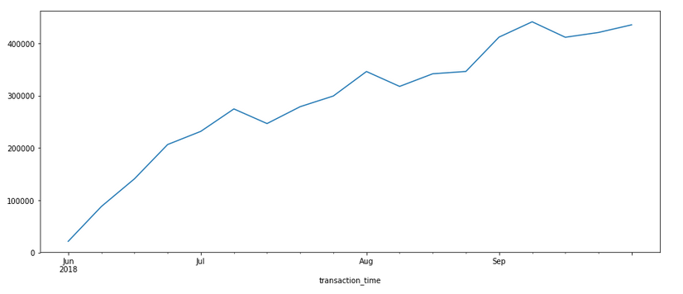
Sales Analysis
Sales data is plotted and it shows that during 4th week of every month, there is increasing trend of sales . Also overall there is increasing trend in the sales.

Slide 22
Insights and Recommendations

Slide 23
Company can change their marketing strategies based on customer segmentation and increase their profitability and reduce customer attrition
Company can focus more on top revenue generating and top selling products to increase revenue.
Company can offer more and club low-selling products with high-selling products during off-peak hours to boost the sales.
Company can focus more on combo-offers for the products which are sold together
Company can offer more to boost sales during 1st and 2nd week of every month to boost sales.
Company should focus on low revenue-generating stores and see why they are not performing

Slide 24
GitHub Reference
The project is developed using Python and the python code file is available in GitHub in the following location:
https://github.com/KrishnaGoswami/AnalyticsProjects/blob/master/RFMCoffeStores/RFMAnalysis_CoffeeShop.ipynb

Slide 25
Thank You

